Slide 1
A Project on Quiz Application Submitted by – Rajput Aayush
TO Faculty : Prof. Vanadana Patel
ENROLLMENT NO : 2104030100809
BCA SEM-5
DIV : C

Slide 2
Introduction
As we can see in today’s time every work in the world has been digitalized.
So by seeing this changing environment most of the Schools and colleges has took there Education system on new level by using technology.
So inspired by this new tech we have made the test and quiz online for students.
This will help them to build there knowledge more accurately and in a very enjoyable way.

Slide 3
Objective
By making this application we have a very clear intention for giving our best way and resources to students for learning.
Because of this application students will able to build their Skills and Knowledge from anywhere and anytime.
And by seeing their progress they will also get know about their weak points in which they have to work.
And also teachers can check their students performances through this application which will help them to teach them in an accurate way.

Slide 4
Tools / Platform used Hardware and Software
Programming Language : JAVA , SWING
RAM : 2 GB minimum required
Processor : Any Modern Processor will suffice
OS : Windows , MacOS & Linux

Slide 5
Tools / Platform Hardware and Software
GUI and Library : SWING
Hard Disk(for this sample) : 10mb of free disk space

Slide 6
Module Description
Overview:
This application is made for students online exams and quizzes for daily practice.
It is made by in a user friendly way which will be easy to use.

Slide 7
Module Description
Target Users :
Students
Teachers
Admin

Slide 8
Scope of Project
This application is made in a simple way so it make students comfortable to use it.
It includes the educational data which are referred from all types of educational resources.
Will make changes in application time by time so it can keep students motivated and they learn with more interest.

Slide 9
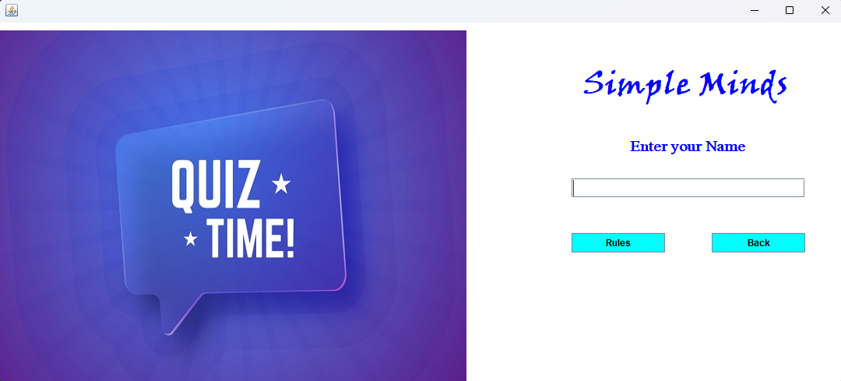
Login Page

Slide 10
Login Page
As we can see in previous slide the login interface of page.
The user has to write his name in “Enter your name” box to continue further.
If the person has to go back he can click on “Back” button and if he want to continue to give quiz then he can click on “Rules” button.

Slide 11
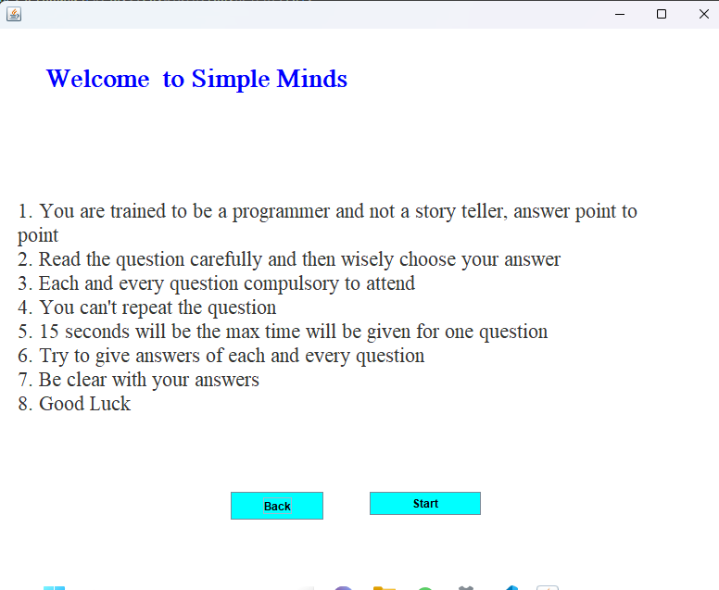
Rules Page

Slide 12
Rules page
After clicking on “Rules” we can see the set of rules which the user has to read and follow before attending the exam.
Then if the user is agreed to all the rules then he/she can proceed ahead by clicking “Start” button.

Slide 13
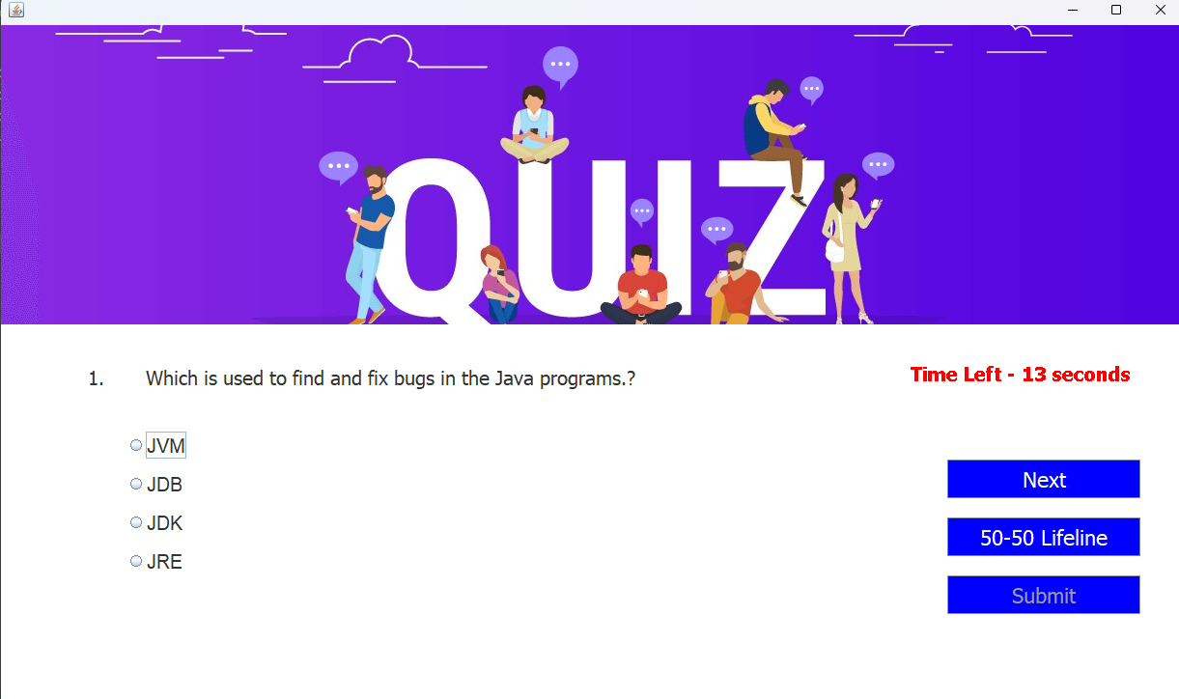
Questions & Options

Slide 14
Questions & Options
As we can see the questions starts to appear with options and the user will get 15 seconds to complete each question.
After selecting an option user can click on “Next” button for further questions.
There will be no previous button so if the time is up then that question will be skipped.

Slide 15
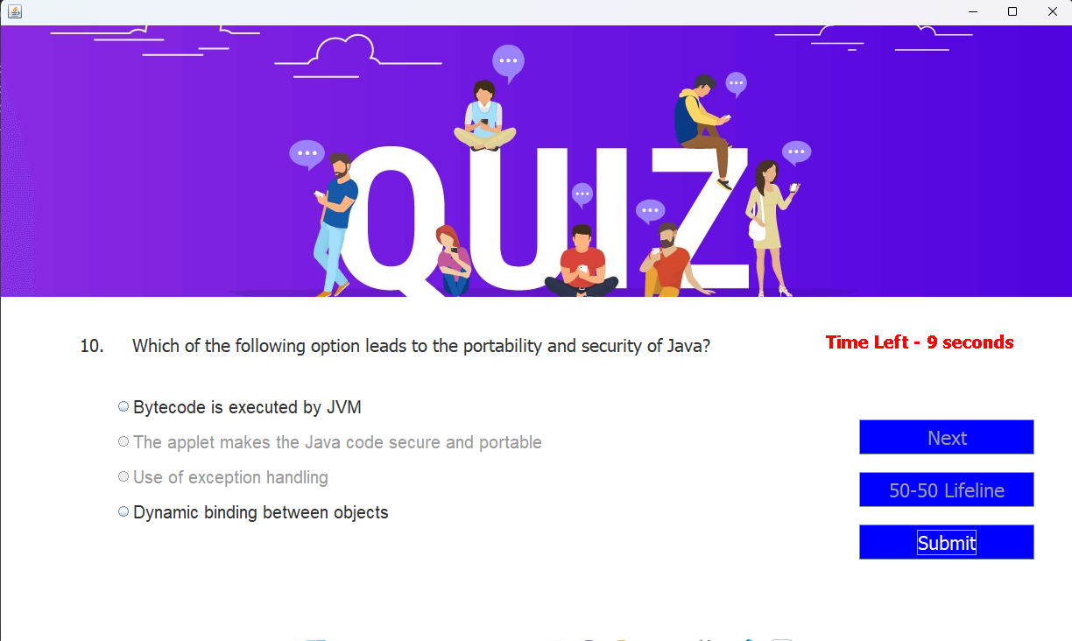
Questions & Options

Slide 16
Questions & Options
To make the Quiz interesting we gave the 50-50 lifeline in which the 2 wrong options will be gone.
But the user can use that option only one time.
After completing all questions there is “Submit” button the user has to click on it to complete the quiz.
Than the marks will be calculated.

Slide 17
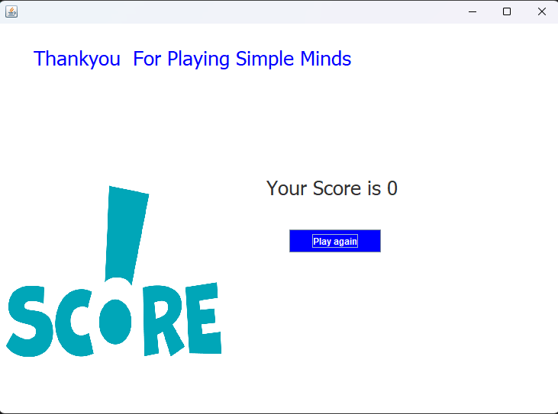
Score

Slide 18
Score
After completing exam the program will check your score(Right Answers).
Then it will be shown to you and if you are willing to attend the Quiz again you can click on “Play again” Button.

Slide 19
Further Enhancement of the Project
This was just the sample model (Idea) of the application, will try to improve speed.
Further this application will be connected to database using MySql.
The data of students will be stored in MySql.
Further that application will be made in Android Studio and many more changes will be done.

Slide 20
THANK YOU

